Slide 1
Concept, Task, Reference:
A practical guide to choosing the right topic type
Real World DITA Conference
September 2009
Larry Kunz
lkunz@sdicorp.com
www.sdiglobalsolutions.com

Slide 2
Outline
The Topic Types
Best Practices
Naming Your DITA Files
Resources
Notes:
This presentation is for beginning to intermediate users of DITA
It’s based on my experience with projects on which I’m PM, Info Architect,
and writer
It’ll cover:
What the 3 primary topic types (C-T-R) are….
….and what they’re not
Best practices for choosing between the 3 topic types
Sometimes content doesn’t fit neatly into a single type
There’s a gray area – I’ll try to shrink the gray area
Both theoretical and practical tips
Naming the files that contain your DITA content
Why it matters
Best practices do’s and don’ts
List of resources at the end

Slide 3
The Topic Types
Task
Concept
Reference
Generic (no particular context)
Glossentry (special type)
Notes:
The topic types:
Task – I list this one first, because concept & reference both are based on it
Concept – Background information helpful for doing the task
Reference – Quick look-up, or supporting information for a task
Glossentry – A specialized topic type; not covered here
Generic – Also allowed
Journalism 101: Who, what, where, when, why, and how
Task topics cover the HOW
Concept & reference topics cover the who, what, where, when, why

Slide 4
The Topic Types
Why not just use generic topics?
Clearer focus
Specialized elements
Better cross-references
Notes:
Why not just use generic topics?
Clearer focus:
Using topic types, writers can focus on providing a specific type of content
(I’m a writer….I know writers….Even the best ones need help to separate content in a way that supports the audience’s need to perform a task)
The alternative (potentially): Topics that are a hybrid of C & R, perhaps with a few task steps sprinkled in….Reader sees them as unfocused, muddled
Specialized elements:
Task topics have specialized elements – e.g., <steps> <prereq> <postreq>
If you use generic topics, you have to use common elements (like <ol> and <p> ) to build those kinds of information
Better cross-references:
When you put the topics into a reltable, the output will break out the list of references by topic type, e.g., “Related concepts”
If you use generic topics, you just get one big list: “Related topics”

Slide 5
Task
From the DITA 1.1 Language specification:
Task topics answer "How do I?" questions, and have a well-defined structure that describes how to complete a procedure to accomplish a specific goal. Use the task topic to describe the steps of a particular task, or to provide an overview of a higher-level task.
Task topics answer questions like :
How do I do this?
What do I need before I start?
What will happen when I finish?
(continued)
Notes:
From Practical DITA (Julio Vazquez):
“Task topics should be the starting point when you write information. They keep you focused on the user's view of the product you are writing about rather than the functions contained in a product.”
Task topics have specialized elements…
e.g., <steps> <context> <prereq> <postreq>
….that can only be used in task topics

Slide 6
Task
Task topics should contain:
Steps to complete a specific operation
  Replace the printer cartridge
  Set up the database
  Complete the application form
Prerequisites
Brief explanation of the context in which the steps are performed
Examples (optional)
Results (optional)
Next steps (optional)
Task topics should not contain more than a small amount of conceptual or reference information
(more on that later)
Notes:
Task topics should contain steps to complete a specific operation
Replace the printer cartridge, complete the application form, etc.
Also:
Prerequisites
Brief explanation of the context in which the steps are performed
Examples (optional)
Results (optional)
Next steps (optional)
Task topics shouldn’t contain more than a small amount of conceptual or reference information
How much is small? I’ll have more to say about that later

Slide 7
Concept
From the DITA 1.1 Language specification:
DITA concept topics answer "What is..." questions. Use the concept topic to introduce the background or overview information for tasks or reference topics.
Concept topics answer questions like :
Why am I doing this?
What principles do I need to keep in mind?
What’s the big picture?
What other things might be affected by the choices I make?
(continued)
Notes:
The concept provides background info
The task topic just says “do this”
The concept topic gives insight as to why you’re doing this….
….And where “this” fits into the big picture
Why am I doing this? Needs to be audience-specific
What principles do I need to keep in mind?
What’s the big picture? and its corollary….
What other things might be affected by the choices I make here?

Slide 8
Concept
Concept topics:
Set the context for a task or tasks
  Less than 1 or 2 paragraphs can go into the task topic using a <context> element
Develop knowledge that the user needs to perform the tasks
  Example: “What is storage management?”
  Detail-oriented knowledge goes into reference topics
Describe how tasks fit together
Notes:
The concept topic should provide context
Two scenarios:
Task topics where it takes more than 2 paragraphs to explain the context (IMO that’s the max size for a <context> element)
ESPECIALLY re-usable DITA topics: they don’t have any inherent context
The concept topic should also provide background information:
As I’m doing this task, what should I know in order to make intelligent choices?
e.g., “Principles of managing storage”
What other things will be affected by the choices I make here?

Slide 9
Reference
From the DITA 1.1 Language specification:
Use the reference elements to describe regular features of sets of things, most commonly the commands in a programming language. However, this format is also suitable for recipes, bibliographies, catalogues, and similar collections of structured descriptive prose.
Reference topics answer questions like:
Which option do I want?
What does this mean?
(continued)
Notes:
Reference topics should contain “just the facts, ma’am”
Examples:
A set of options or command parameters
Meanings of fields that are displayed on the screen
Drawings showing, say, the controls on a lawn mower
Schematic diagrams
They answer the questions
What does this thing (input field, hardware doohickey) do?
What are the valid choices, and which one do I want?
I think that most of us have an instinctive sense of what a reference topic is
Don’t overcomplicate it, for example….

Slide 10
Reference
Reference topics should not contain:
Steps from a task
Contextual, background, or overview information
Examples of what they should contain:
Lists of options, parameters, etc.
Extended examples
Troubleshooting tips
(symptom/cause/fix)
Notes:
Don’t include steps from a task
What about subtasks that used in many different tasks
Example: Click Start > Settings > Control Panel
Would you put something like this into a reference topic….
….With the task topic saying something like “Open the Control Panel; if you need to know how, refer to Topic X” ?
No….I’d make that substeps within a task step, or another task
Don’t include information that belongs in a concept topic
Think of a reference topic as a “quick look-up” to use while performing a task
Not, “Before you do the next step, here’s a long treatise on the philosophy behind managing storage”
(If you doc is organized this way, you really need to re-think)
Examples of what you should put into a reference topic:
Lists of options, parameters, etc. (the most obvious use for a reference topic)
Extended examples – also OK….These can be very useful while doing a task, yet they’d clutter things up if included in the task topic
Troubleshooting tips (symptom/cause/fix) – as long as they’re brief

Slide 11
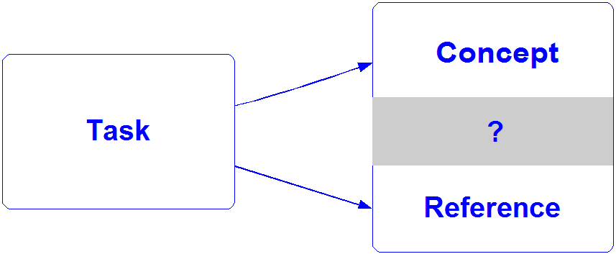
Best Practices: Shrinking the Gray Area
Notes:
The main topic type is the task; other topic types depend on it
The task is exactly what the user needs to do
Concept is background info the user needs to understand
Reference is one-off info the user might need to refer to
But there can be a gray area between concept and reference
I’ve tried to help shrink the gray area in these last few slides….
….But a few examples might help too

Slide 12
Best Practices: Shrinking the Gray Area
Concept or Reference?
1. The simple rule of thumb: Is it mostly prose, or mostly tables and lists?
  In many cases this is enough to decide
  Tables and lists almost never go into a concept topic
2. If prose, what does it say?
3. How often will a reader need to use it?
  Once, to gain understanding (concept)
  Often, to look up details (reference)
Notes:
First rule of thumb:
Sometimes you can tell whether a topic is a C or an R just by looking at it
Is it mostly prose (paragraphs)? Or mostly tables and lists?
Tables and lists are almost always a sign of a reference topic
These elements indicate the “quick look-up” that characterizes a reference topic
OTOH, lots of prose usually indicates a topic that’s not “quick look-up”
Second rule of thumb:
The first rule isn’t foolproof….
….You should always evaluate the content of the topic before making a final
“C or R” decision
In other words, what does the prose say?
If the topic gives “big picture” or background info, or if it shows interrelationships between components, it should be a concept
But if it contains details about a particular thing, it might be a reference
e.g., Detailed description of the ABC component
Third rule of thumb:
(Courtesy of Julio Vazquez, again)
How often will a reader need to use it?
Once, to gain understanding (concept)
Often, to look up details (reference)
Similarly (courtesy of Tricia Garrett, IBM):
Will the reader read it straight through (concept), or….
Will the reader just pick out the parts they need (reference)?

Slide 13
Best Practices
Concept or Reference?
Example 1
Summary of medical requirements for traveling outside the U.S.
Notes:
The US Dept of State has a nice website (“Tips for Traveling Abroad”)
It includes, for example:
Paperwork/required documents
Customs laws
Health: Vaccinations, health warnings, medications you can bring

Slide 14
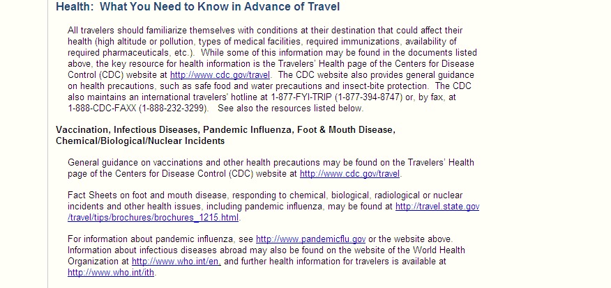
Best Practices
Concept or Reference?
Example 1
Notes:
Concept or reference?
Remember the rule of thumb: Mostly prose, or mostly lists?
But….Even though this looks like a concept, I’d make it a reference
Why? The third rule of thumb:
How often will people refer to it?
They’ll probably read it every time they prepare for an international trip, until they’ve mastered the information
It doesn’t explain background info; it just tells you facts that you need to know as you prepare for a trip
Not designed to be read it in sequence….People will just grab the bits that pertain to them
The paragraphs are relatively short; full of links, phone numbers, etc.

Slide 15
Best Practices
Concept or Reference?
Example 2
“How it works” descriptions for minor (or optional) product components
Notes:
Our documentation set includes topics that describe “mediation primitives” – pieces of code that a programmer can use to build a message-handling flow.
They consist of a description (usually a sentence or two) and one or more of:
File headers included
Policies used
Operations performed (with descriptions)
Configuration parameters
Concept or reference?
We’ve made these into reference topics
But….If the description is more than a couple of paragraphs, consider breaking it out into a separate concept topic
Why break a topic like this into two (C & R) ?
Audience needs: The reader might need the description only once, but they’ll need to return to the “technical stuff” again and again
Reuse….There might be a context in which you want the description without all of the technical stuff – or conversely, where you just want the technical stuff

Slide 16
Best Practices
Concept or Reference?
Example 3
High-level summary of a process that contains several different tasks, perhaps in different sequences
Notes:
Example: “To install Product X you begin by clearing sufficient disk space. Then you’ll download the software and execute the installation program. Finally, you’ll customize your options using the Customize window.”
(Followed by a series of task topics)
Concept or reference? This can be a concept topic, used as a container (parent topic) for the task topics.
Even though it implies a sequence (like a list) it’s not a reference…
…It’s not information that a user would look up while doing a task.
Alternative: You could also make this a task, with each step containing a pointer to a specific task topic.
Some style guides require this, i.e., that the container for a set of task topics be a task topic itself

Slide 17
Best Practices
Reference info in task topics
Some reference info in a step is OK
But move it to a separate reference topic when:
It interrupts the task flow
(this is subjective)
The reference info can support several different tasks
Notes:
A few more best practices:
General guidelines from when to move reference info (e.g., a table) out of the task topic and into a separate reference topic:
If it’s so big it gets in the way of the task flow (this requires knowing your audience and the task they’re performing)
This is subjective, but I’d say that a full screen of reference info is definitely too much (example coming up)
Also, when reuse is likely
Short tables or lists can be conref’d
But larger chunks of information should be moved to a separate topic
Sometimes these things just grow – they start out small, then they slowly get bigger and bigger
Be alert to when this happens, and don’t be afraid to pull the trigger and create a new topic
What’s too long? Let’s look at an example….

Slide 18
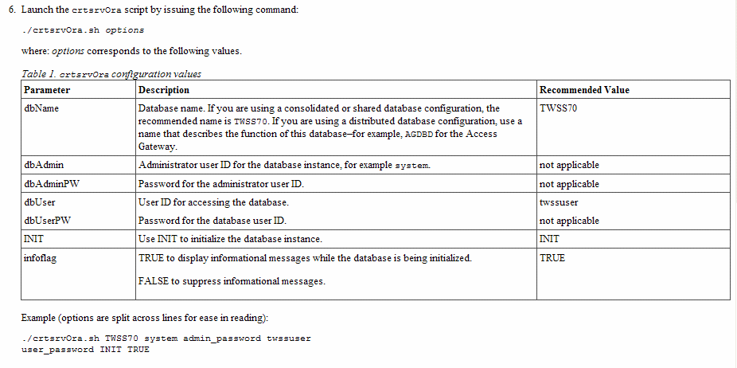
Best Practices
Too much for a task topic? (Before)
Notes:
This task topic attempts to include helpful information right inside a step
Purpose: Keep the reader from having to move off the topic to look up info
But this is too much reference info to contain inside a task topic
See how cluttered it is? (Remember, this is just one step)
The flaw here is in trying to explain too much about the parameters (see the Description column of the table)
This probably needs to be relegated to a reference topic and linked from the main task

Slide 19
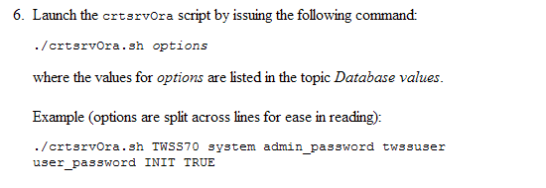
Best Practices
Too much for a task topic? (After)
Notes:
Here’s the After shot….I’ve created a new reference topic called Database values, and moved the table there.
Otherwise, this is the same exact step
Much, much less cluttered. And an intermediate-to-advanced user who already knows the options isn’t going to be tripped up.

Slide 20
Best Practices
Avoid in-line cross references
Easier to avoid stale links
Easier to keep track of all the links; they live in a central place
Inline links tempt users to click them
Use reltables instead
Notes:
When mentioning the need to draw reference info out of task topics and into separate reference topics….
….It’s worth noting the best practice for cross references
I advise AGAINST simply replacing the table or list (in the task topic) with a link to the reference topic
Better to include a citation (<cite> tag) and let DITA put the link at the end of the topic, in “Related References”
Reasons:
Links can get stale! The link that works OK today might be broken a year from now – and then you’ll have to remember to come back and fix it
Leads to the second point: It’s easier to manage all of the cross-references when they’re in a central place, i.e., a reltable
Finally, a power user might not need the reference information….But it’s tempting to click a link even when you don’t need it
Don’t lead your users astray

Slide 21
Best Practices
Organizing the topics
What information model(s) is/are you using?
Book: Imagine the material being read front-to-back
Context-sensitive help: Group C,T, and R topics with one another
YMMV
Note: This might help you decide whether a specific topic should be a C or an R
Notes:
How best to organize the topics in your documentation set?
(The organizing takes place in your DITAMAP)
It depends on whether you’ll produce it in a traditional printed format (book, brochure, whatever) or an online format
Book: Assume that your reader will read the material front-to-back
You’ll probably create chapters, each containing all 3 topic types (C-T-R) for a related set of information
Online: You can do it the same way, especially if you’re using a format (like Eclipse) that has a navigation pane
Or if the topics fall into natural C-T-R groupings that could be reused, as a group, in another doc set
But you could group all concepts together, all tasks together, and all references together
This is handy if the C & R topics are extensively reused within the doc set….
….You don’t need to make artificial groupings of topics; instead you handle their interrelationships using a reltable
Note: If you’re still not sure about whether a topic should be a concept or a reference, grouping them by topic type could help you decide
e.g., You see a reference topic that doesn’t look like any of the other reference topics…..Maybe it should be a concept

Slide 22
Best Practices: Summary
Overriding considerations:
What do the tasks look like from your user’s point of view?
Where is the information being reused?
What information model(s) is/are you using?
Notes:
Summary of all these best practices:
When your target audience uses the information, will it make sense?
Organized appropriately
Appropriate background (concept) and reference info with each task?
Reuse:
Removing context-setting info from tasks is key when tasks can be reused in a number of different contexts
(Move it into a concept topic)
If a reference topic is going to be reused within your doc set, don’t feel constrained to locate it near the calling task topic….esp. in online help
Information model: Book vs. online
Sequential vs. hyperlinked

Slide 23
Naming Your DITA Files
Your goals:
Easily view and manipulate file names, for example in the CMS list
Easy for others (new team members, or people who reuse your files) to understand what the topics contain
Distinguish C,T,R topics
  Easier to build a reltable
  Easier to identify where topics should go when building a new map
Notes:
Filenames matter!
(I’m not talking about topic titles….
….I’m talking about the names of the DITA files in your CMS)
You want to have file names that:
Make sense
Are easily displayed and manipulated (e.g. alpha order)
Can readily be understood by all team members (including those that come on board mid-project)
Easily deciphered filenames come in handy when you're setting up the reltable
Can more easily distinguish C, T, R – for building reltable or setting up navigation
Also helps writers find the files they want to re-use
Note: For a full file taxonomy, you should use metadata
But a good system for naming files can complement your file taxonomy
Some examples follow….

Slide 24
Naming Your DITA Files
Make names meaningful, not cryptic Instead of: dc_c
Try: database_connections_c
Don’t just parrot topic titles
Instead of: settinguptheprimaryserver_t
Try: setup_primary_server_t
Instead of: parametersthataffectsystemperformance_r
Try: perf_parms_r or performance_r
Keep names distinct from each other
Instead of: db_setup_t and db_setup_r
Try: db_setup_t and db_setup_parms_r
Notes:
Make names meaningful, not cryptic
File names should make sense even when the topic is reused in other contexts
Also, it’s tempting to use names that are short & sweet – they’re easy to type, etc.
But a month from now you won’t remember whether dc_c is about Database Connections or Distributed Configurations
So, OK….Let’s make the names long – perhaps parroting the topic title
These are very hard to work with, if you have to jot down notes or something
Note: I know at least one editor that generates these automatically
I inherited a 500-topic library with names like these. Ouch!
To sum it up: Find the happy medium between names that are too short (and cryptic) and too long (and difficult for humans to process)
Keeping names distinct: Avoid names that are too similar
The reason for this should be obvious

Slide 25
Naming Your DITA Files
Avoid using code names for products that are still in development
Instead of: mothra_installation_t
Try: ip_gateway_installation_t
Use names that reflect topic contents, not metadata
Instead of: department_installing_t or writername_installing_t
Try: productname_installing_t
Try to have a consistent approach
Instead of: server_migration_c and migrating_databases_c
Try: server_migration_c and database_migration_c
or migrating_servers_c and migrating_databases_c
Notes:
Note about code names (internal names for yet-to-be-released products)
They might make sense now, but they’ll look pretty tired & worn out a year from now
Plus, people who come onto the project later won’t know what the names mean
If a product name isn’t available, try using a description of what the product does
In this example…
Mothra is the code name (it was a code name on an actual project I once worked on)
The yet-unnamed product is a gateway to the IP network
….So I used “ip_gateway” in the file name rather than “mothra”
Names that reflect topic contents….
….Not a department name, or a writer name – inevitably, those will change
You might think this would go without saying – but I’m saying it anyway
Consistent approach:
Don’t switch positions of “migrating” and “migration” like in the example
It’ll only lead to confusion as time goes by – in this example, writers might assume that there’s a distinction between the files – when in fact they were just named carelessly
To avoid this, take the time up front to establish file-naming guidelines
Might seem like a waste of time, but worth it in the long run
Alternative: Bar writers from creating new files (and hence naming them inconsistently)
I avoid this because
It’s too restrictive, and
Even as the IA, I still can’t trust myself to be consistent from one day (hour) to the next

Slide 26
Naming Your DITA Files
Summary of recommendations:
Put yourself in the writers’ shoes
The underscore character is your friend
Be descriptive without being verbose
Use suffixes: _c, _t, or _r
Consistency is a virtue
Promulgate file naming conventions as part of your style guide
Notes:
Summary of file-naming recommendations:
Put yourself in the writers’ shoes: Your file naming strategy should be geared around making the content providers’ lives easier
(Earlier, the best practices for C-T-R were for making end users’ lives easier)
The underscore character is your friend: Use it to break up long text strings into logical pieces
Be descriptive without being verbose: Find that happy medium between too short and too long
Use suffixes (_c, _t, or _r): Distinguishing the topic types helps in building cross-references and in re-use
Consistency: Makes things easier to find, avoids confusion
Promulgate file naming conventions as part of your style guide

Slide 27
Resources
DITA 1.1 overview
http://docs.oasis-open.org/dita/v1.1/overview/overview.html
DITA 1.1 architectural specification
http://docs.oasis-open.org/dita/v1.1/CS01/archspec/archspec.html
DITA 1.2 implementation status (list of new features)
http://wiki.oasis-open.org/dita/ImplementationStatus1.2
dita-users Yahoo group
(great resource for getting your questions answered)
http://tech.groups.yahoo.com/group/dita-users/
Notes:
In addition to the resources listed, there’s also a local DITA users group
For those who are located in the Triangle area….
We meet the 4th Wednesday of each month at 5:30
We also hold joint sessions with DITA User Groups in Boston and Providence

Slide 28
Your turn
Q & A

